Slide 1
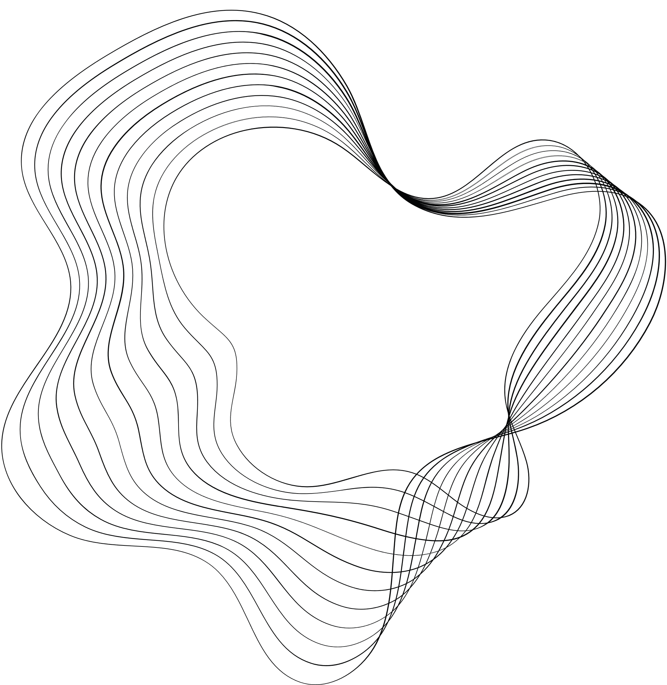

VASANTDADA PATIL PRATISHTHAN'S COLLEGE OF
ENGINEERING AND VISUAL ARTS
Department of Artificial Intelligence and Data Science
WEB-BASED SPOTIFY CLONE
GROUP MEMBERS:
AYUSH GUPTA (VU2S2324001)
SNEHA PACHPINDE (VU2S2324002)
SAYALI GHADGE (VU2S2324003)
NABEELA ASHRAFI (VU2S2324004)
PROJECT GUIDE:
PROF. RAJESH KHOTRE

Slide 2

OUTLINE
01
INTRODUCTION
02
PROGRESS OVERVIEW
03
CHALLENGES AND SOLUTIONS
04
WORK COMPLETED SINCE LAST UPDATE
05
PENDING ENHANCEMENTS
06
CONCLUSION

Slide 3



INTRODUCTION
Welcome to the evolution of musical immersion! Previously crafted with the simplicity of HTML, CSS, and JavaScript, our web-based Spotify clone is now poised for a transformative journey towards full-stack integration. Still, at its core, it remains a harmonious fusion of melody and technology. With enhanced features including basic playback controls, playlist management, and volume adjustments, our platform offers an immersive auditory experience. Embark on a musical voyage where every beat and melody is at your fingertips. Join us as we redefine the boundaries of auditory exploration with our intuitive and user-friendly interface.

Slide 4
PROGRESS OVERVIEW
Our Spotify clone has undergone significant evolution, now featuring a complete backend system and database integration. Users can seamlessly add, play, pause, skip, and control the volume of songs. Challenges in learning Next.js and Supa base from scratch have been overcome. Originally a frontend-only project, it has now been fully revamped, laying the foundation for future enhancements such as seek bar functionality and API integration for direct song fetching.

Slide 5
CHALLENGES AND SOLUTIONS
Challenges arose in mastering Next.js and Supabase from scratch for our Spotify clone project. Adapting to these new technologies required significant learning curves and troubleshooting. Despite initial hurdles, diligent effort and resource utilization helped overcome these obstacles, enabling successful integration and advancement of our project.

Slide 6
WORK COMPLETED SINCE LAST UPDATE
Since the last update, substantial progress has been made on our Spotify clone project. We've successfully implemented a complete authentication system, enabling users to sign in securely and verify their profiles via magic links. Additionally, users can now enjoy enhanced functionality, including the ability to add new songs, control playback (play, pause, skip), and adjust volume settings.

Slide 7
PENDING ENHANCEMENTS
Pending enhancements for our Spotify clone project include implementing seekbar functionality to allow users to easily navigate through songs. Furthermore, we aim to integrate an API for direct song fetching, streamlining the user experience by providing access to a wider range of music selections. These enhancements will further enrich the platform's functionality and user satisfaction.

Slide 8
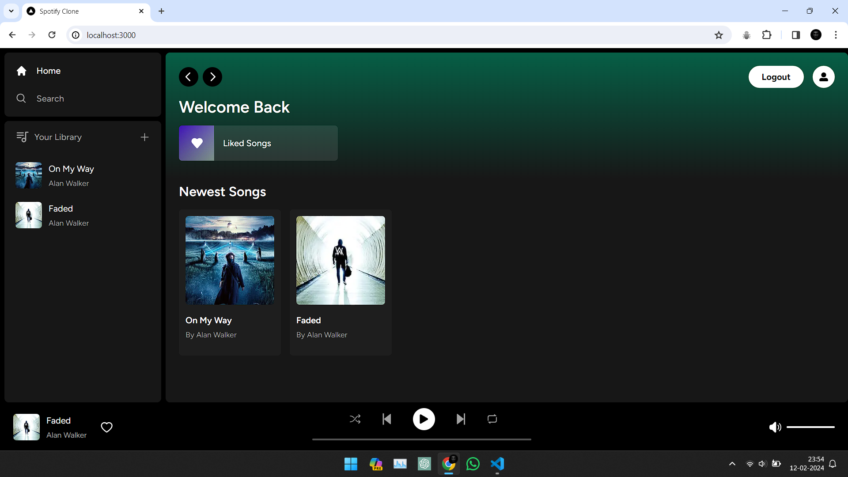

Slide 9
CONCLUSION
In conclusion, our Spotify clone project has made significant strides, introducing authentication, enhanced functionality, and promising future enhancements.

Slide 10
THANK
YOU!!

